Slide 1

Sandbox
https://pariscon2025.edly.space

Slide 2


Let’s Walkthrough XBlocks
And Unleash the Power of Open edX

Slide 3


Who we are
Farhan Khan
Lead | Engineer
Salman Nawaz
Software Engineer
Notes:
(Farhan turn)
Awesome, thanks everyone for coming and listening to us.
My name is Farhan, I am Software Engineer, Solution Architect, currently leading Aximprovements team and also a Core Contributor @ Open edX.
(Salman turn)
My name is Salman …

Slide 4
Contents
Team Introduction
Team
Vision
XBlocks Intro
What are XBlocks
What makes XBlocks powerful
XBlocks Walkthrough
Content Creation XBlocks (Non Graded)
Assessment XBlocks (Graded)
AI XBlocks
Feedback & Analytic XBlocks
Further
Q&A
Notes:
We will start with XBlocks intro and then we will walkthrough together diversity of XBlocks
At the end we will have Q&A session

Slide 5
Questions to Ask
How many of you are already familiar with Open edX
How many of you are Developers?
Notes:
Before we get started, I want to ask couple of questions:

Slide 6



Notes:
We are a team of 5–6 engineers called Aximprovements, which is a part of the Axim Collaborative Engineering team.
We are actually employed by Arbisoft, a key partner of Axim and we outsourced to Axim.
Edly, a sister company of Arbisoft providing all kinds of edtech solutions.

Slide 7

Team Vision
Our broader vision is to collaborate closely with the Axim Collaborative Engineering Team to identify and implement architectural improvements that enhance the modularity of the platform.

Slide 8

What are XBlocks?
Building blocks of a Course – like Lego blocks
Enables engaging and highly interactive learning experiences using variety of XBlocks
Technically:
Each XBlock is a self-contained miniature web application
Renders HTML/CSS/JS
Handles user interaction
Notes:
XBlocks are composable building blocks of a Course – like Lego blocks
Every component of a course you are interacting with are actually the XBlocks.
Using diversity of XBlocks built by the community we can make highly interactive and engaging learning experiences
Xblocks walk through is coming ahead

Slide 9
What makes XBlocks powerful?
Highly Interactive
Stateful
Independent
Shareable
Interoperable
Customizable
Composable
Third party Integrations
Extensible
Notes:
Highly Interactive: Variety of highly interactive XBlocks are developed by the community which encourages active learning. For example, drag-and-drop etc.
Stateful: XBlock state is saved and retrieved later during subsequent loads of the XBlock, allowing it to remember user interactions and display data accordingly.
Independent XBlocks don’t rely on other XBlocks to function they are self-contained units who maintain their own logic and state
Interoperable XBlocks work together with other XBlocks. Course authors are be able to combine different XBlocks in flexible ways
Shareable The code you write can be deployed in any instance of the Open edX Platform
Customizable: XBlocks are highly flexible - developers can define fields, views, and handlers to tailor the behavior and appearance of the component.
Extensible You can extend existing XBlocks or develop new ones to suit evolving learning needs, including simulations, quizzes, discussions, or integrations.
Composable: Like Lego bricks, XBlocks can be combined to build larger structures - from small content blocks to entire courses.

Slide 10
What makes XBlocks powerful?
Highly Interactive
Stateful
Independent
Shareable
Interoperable
Customizable
Composable
Third party Integrations
Extensible

Slide 11
What makes XBlocks powerful?
Highly Interactive
Stateful
Independent
Shareable
Interoperable
Customizable
Composable
Third party Integrations
Extensible

Slide 12
What makes XBlocks powerful?
Highly Interactive
Stateful
Independent
Shareable
Interoperable
Customizable
Composable
Third party Integrations
Extensible

Slide 13
What makes XBlocks powerful?
Highly Interactive
Stateful
Independent
Shareable
Interoperable
Customizable
Composable
Third party Integrations
Extensible

Slide 14
What makes XBlocks powerful?
Highly Interactive
Stateful
Independent
Shareable
Interoperable
Customizable
Composable
Third party Integrations
Extensible

Slide 15
What makes XBlocks powerful?
Highly Interactive
Stateful
Independent
Shareable
Interoperable
Customizable
Composable
Third party Integrations
Extensible

Slide 16
What makes XBlocks powerful?
Highly Interactive
Stateful
Independent
Shareable
Interoperable
Customizable
Composable
Third party Integrations
Extensible

Slide 17
What makes XBlocks powerful?
Highly Interactive
Stateful
Independent
Shareable
Interoperable
Customizable
Composable
Third party Integrations
Extensible

Slide 18



Course structure XBlocks
Sequential XBlock
Defines linear navigation across units in a course.
Providing tab experience in edx-platform.
Vertical XBlock
Compose different units on a single screen.
Conditional XBlock
Displays content based on learner performance or actions, enabling adaptive learning paths.
Notes:
Structural XBlocks: Defines linear navigation across a unit in a course
Vertical XBlock: Compose different units on a single screen
Conditional Xblock: Displays content based on the learner’s performance. It enables adaptive learning paths

Slide 19

Kinds of Xblocks
Non-graded XBlocks (Content Creation)
HTML, Video, Poll XBlock
Graded XBlocks (Assessment XBlocks)
Problem XBlocks, Drag & Drop etc.
Notes:
Functionality of XBlocks can be broadly categorized into Graded and Non-Graded
Non-Graded XBlocks: Facilitate content delivery and student engagement without contributing to formal evaluation.
Graded XBlocks: Graded XBlocks enables learners assessment. They automatically score learners, and help instructors track progress.

Slide 20

Content Creation
(Non-Graded XBlocks)

Slide 21

Text/HTML XBlocks

Slide 22

Video XBlocks
Video XBlock supports multiple formats.
HLS Video
MP4 Video
Webm Video
Youtube Video
OGG Video
MPEG

Slide 23

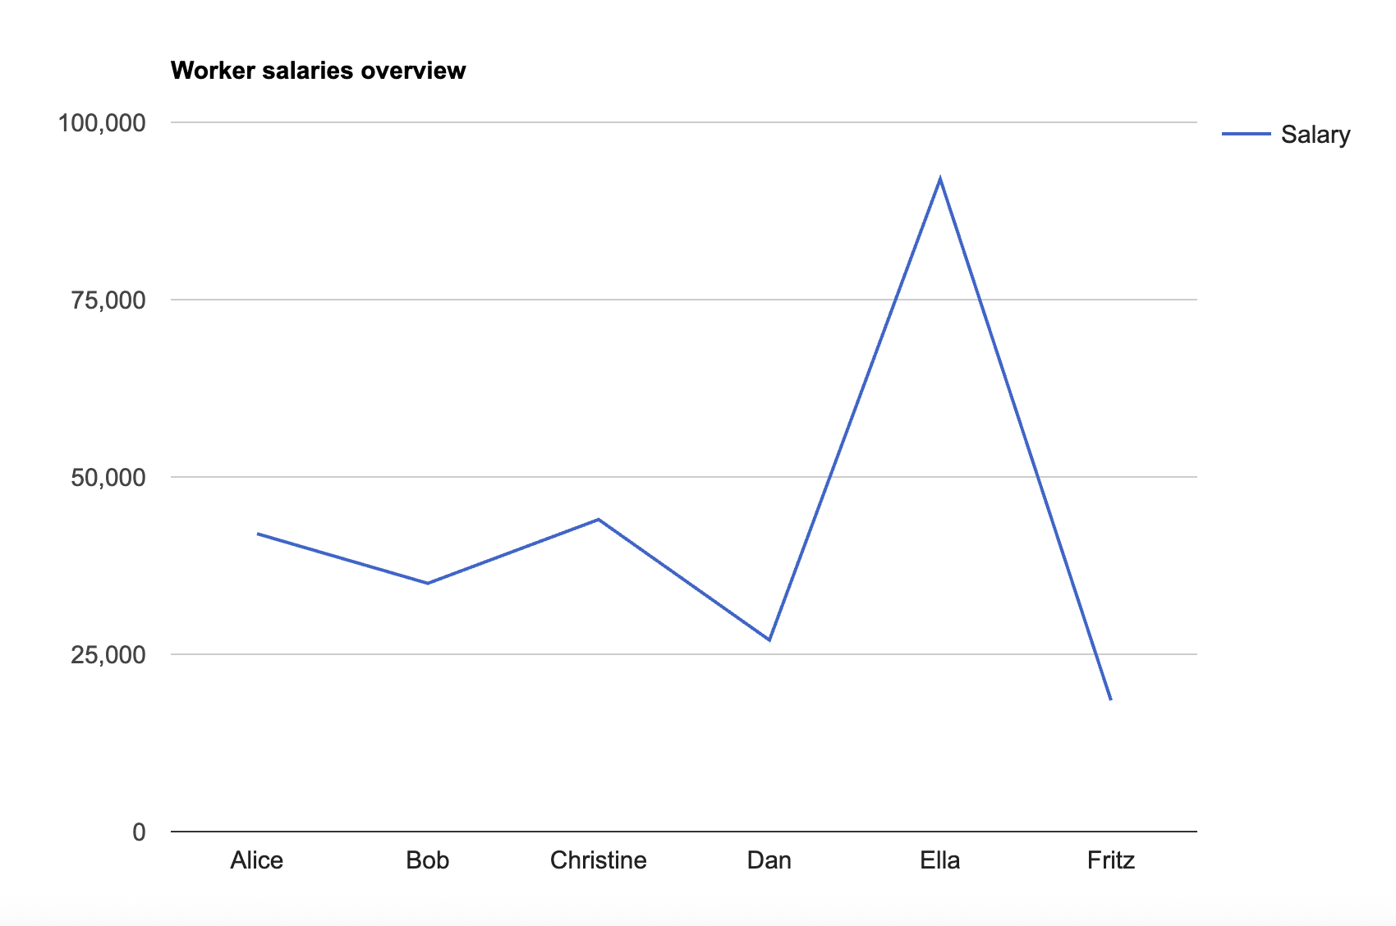


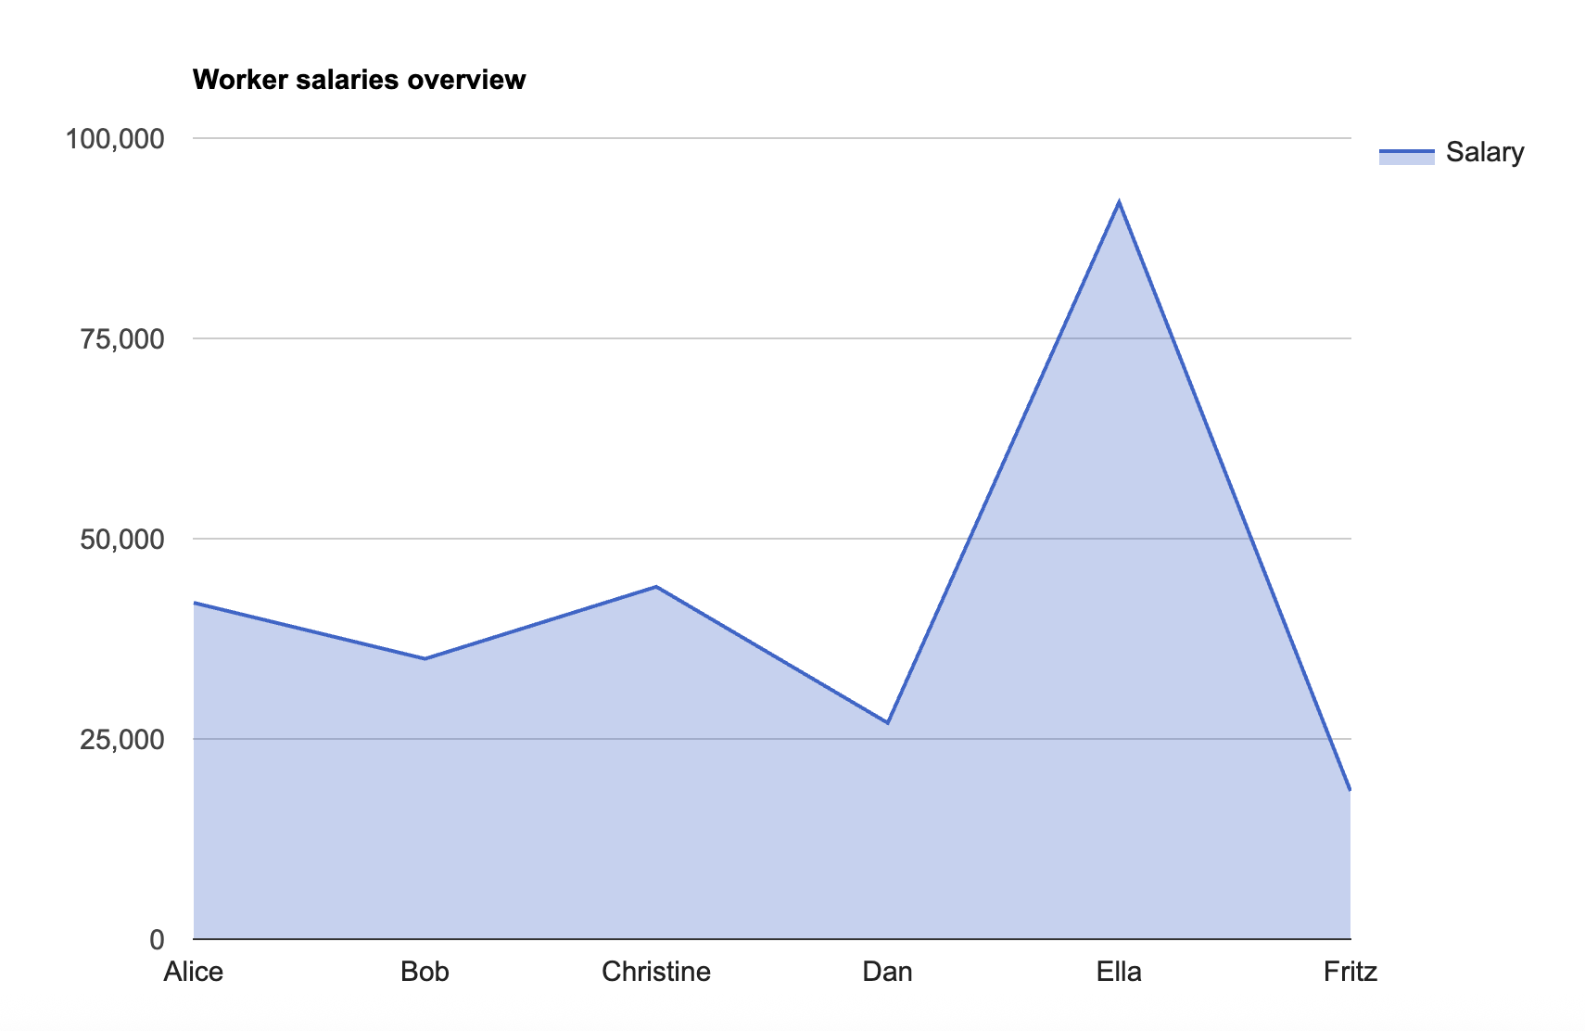

Charts XBlocks
Pie
Line
Bar
Column
Area
Scatter

Slide 24
LTI Consumer XBlock
Stands for Learning Tools Interoperability
It's a standard developed by 1EdTech that allows different educational tools and systems to integrate securely with an LMS
Example LTI’s:
Zoom LTI Pro
Quizizz LTI
TurnItIn
etc. etc.

Slide 25
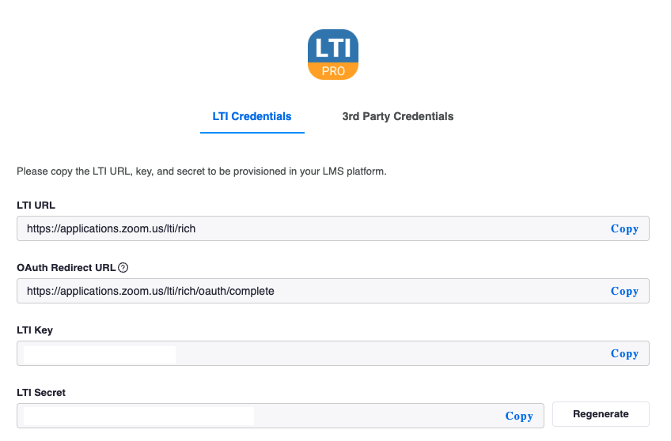
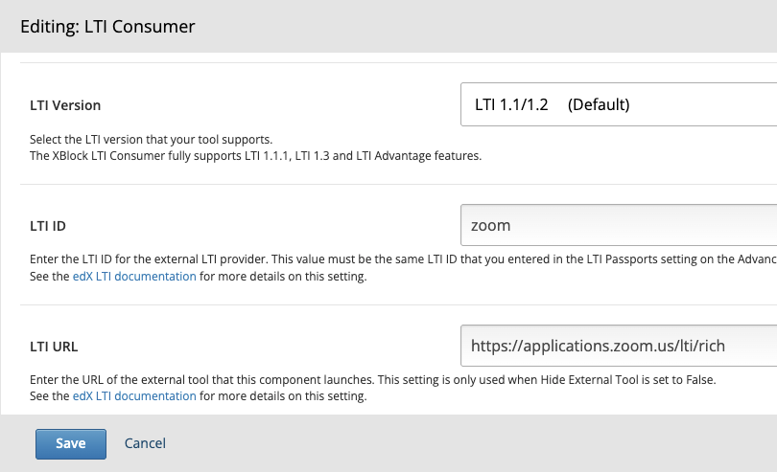
Zoom Integration via LTI
LTI Consumer
LTI Provider

Slide 26
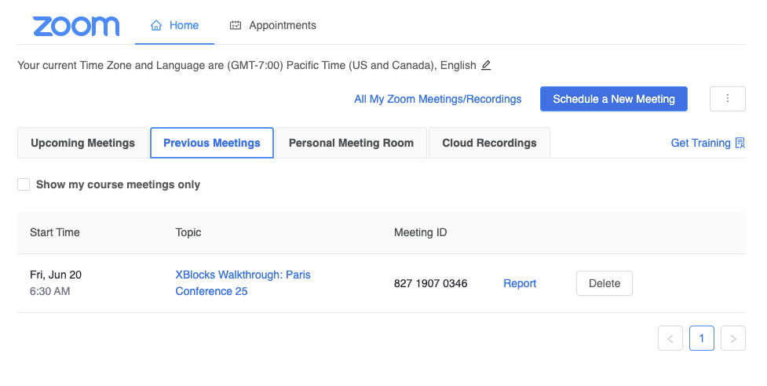
Zoom Integration via LTI

Slide 27

SCORM
Sharable Content Object Reference Model
Set of technical standards for online learning content
Provides a common language for eLearning content and LMSs

Slide 28
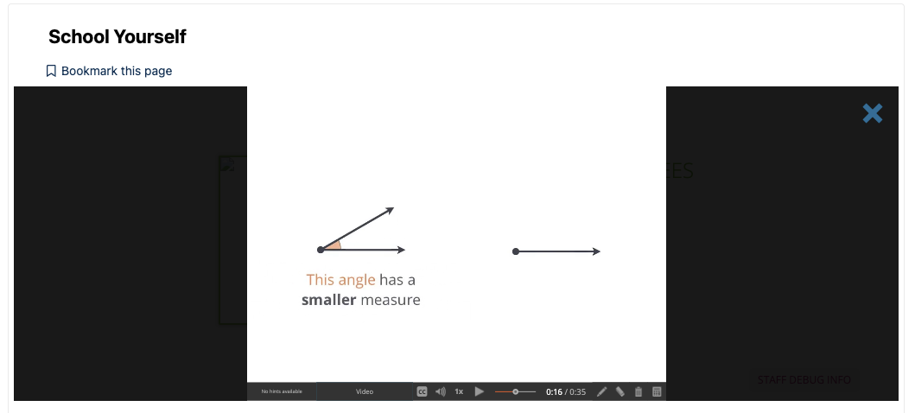
School Yourself
Website that provides free and interactive math lessons
Primarily focused on algebra and geometry

Slide 29
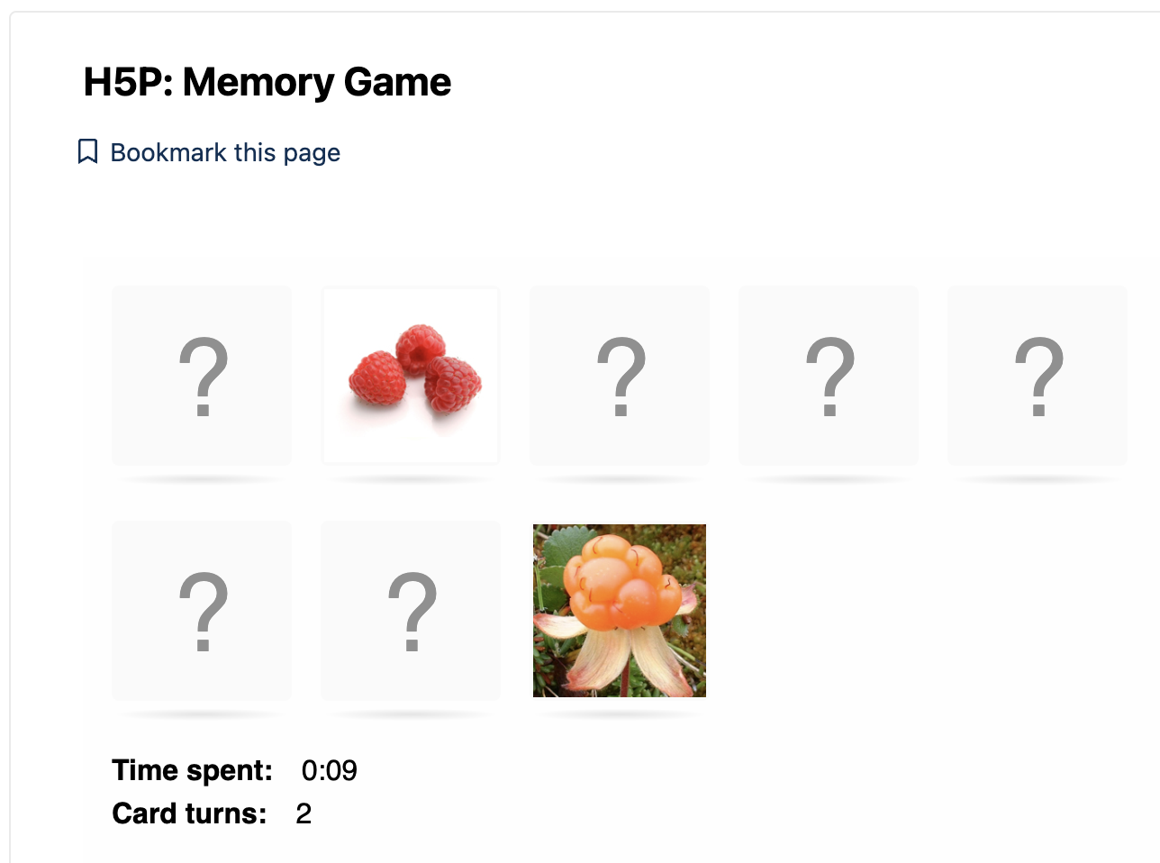
H5P XBlock
A free, open-source tool that allows educators and content creators to easily create and share interactive HTML5-based learning experiences

Slide 30

Google Drive and Calendar XBlocks
Google Document

Slide 31

Google Drive and Calendar XBlocks
Google Calendar

Slide 32

Assessment
(Graded XBlocks)

Slide 33
Problem XBlocks
Common Problem
Advanced Problem
Checkbox
Dropdown
Multiple Choice Questions
Numeric Input
Text Input
Circuit Schematic Builder
Image mapped input
Blank common problem
Notes:
Artificial Intelligence is no longer just a buzzword—it’s now embedded in the Open edX ecosystem. Tools like chatgpt-xblock introduce conversational AI to the LMS, enabling real-time tutoring, clarification, and guidance tailored to individual learners’ needs.
Meanwhile, ai-coach-xblock focuses on providing automated, context-aware feedback on student work. It supports self-paced learning by guiding users through iterative improvement and offering actionable suggestions.
The true advantage of AI-powered XBlocks is their ability to deliver personalized support at scale. Whether for MOOCs or blended learning, they enrich user experience by mimicking the availability and support of a human instructor.

Slide 34
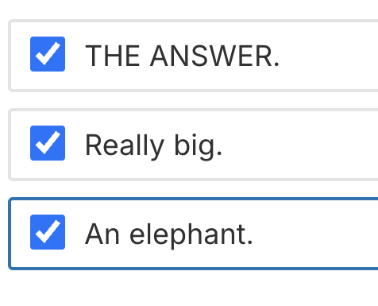

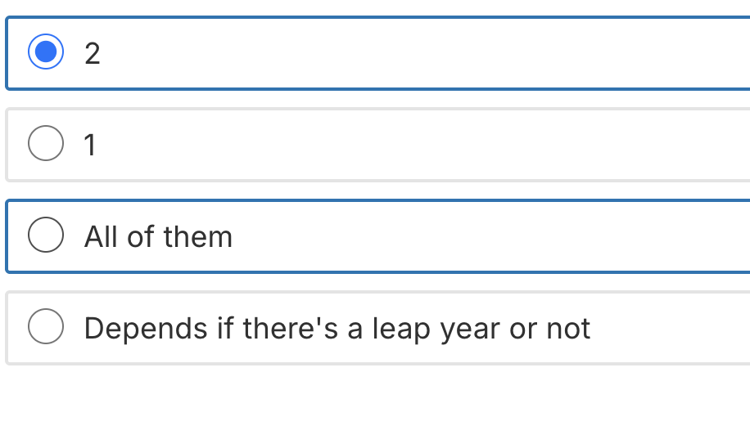

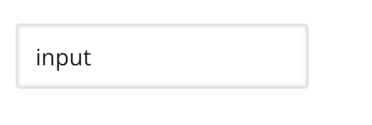
Common Problem XBlocks
checkboxes
Multiple choice questions
Dropdown
Numeric Input
Text Input
Notes:
Artificial Intelligence is no longer just a buzzword—it’s now embedded in the Open edX ecosystem. Tools like chatgpt-xblock introduce conversational AI to the LMS, enabling real-time tutoring, clarification, and guidance tailored to individual learners’ needs.
Meanwhile, ai-coach-xblock focuses on providing automated, context-aware feedback on student work. It supports self-paced learning by guiding users through iterative improvement and offering actionable suggestions.
The true advantage of AI-powered XBlocks is their ability to deliver personalized support at scale. Whether for MOOCs or blended learning, they enrich user experience by mimicking the availability and support of a human instructor.

Slide 35
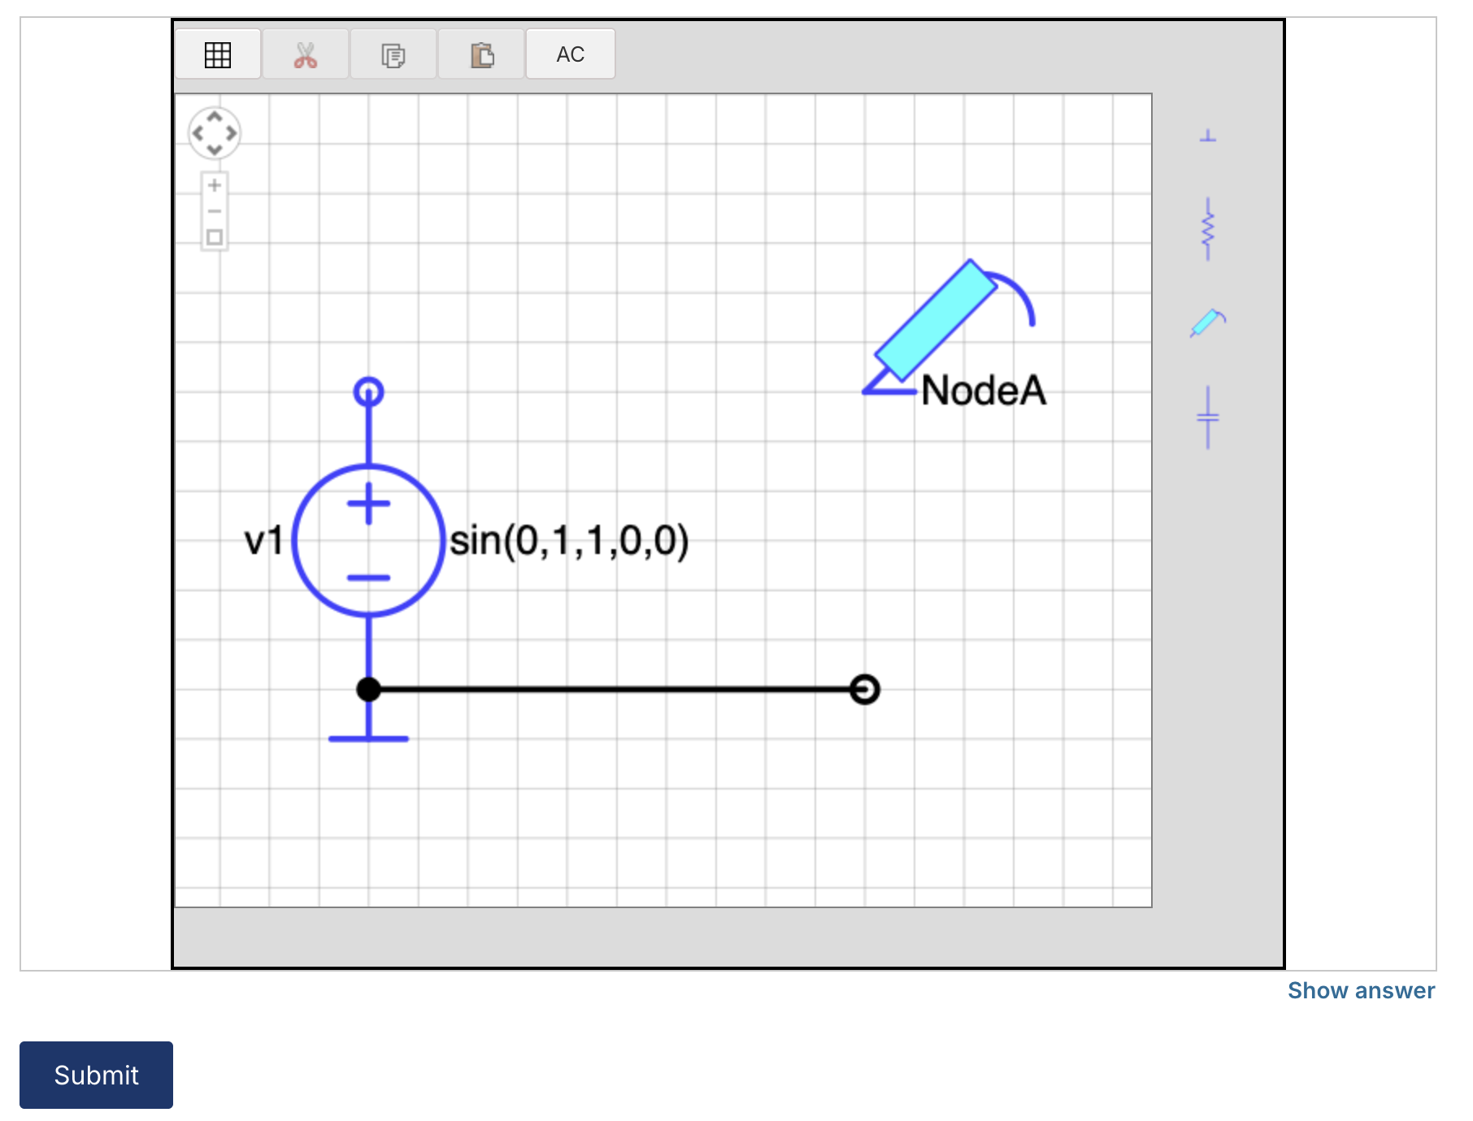
Advanced Problem XBlock
Circuit Schematic Builder
Learners can arrange circuit elements such as voltage sources, capacitors, resistors, on an interactive grid. They then submit a circuits to the system for grading.
Notes:
Online assessment should be as dynamic as learning itself. XBlocks like xblock-sortable introduce drag-and-drop interfaces for tasks that require categorization or sequencing. These are especially useful in fields like language learning and data analysis.
xblock-free-text-response enhances writing skills by capturing long-form responses and enabling either human or automated review. This flexibility supports writing-intensive disciplines and nuanced assessments.
xblock-inline-dropdown adds interactivity to reading by embedding quizzes directly into the content. Learners can engage with material while being tested in real time. Together, these tools diversify assessment strategies and make evaluation both formative and learner-centric.

Slide 36

Advanced Problem XBlock
Image Mapped Input Problem
In an image mapped input problem, also known as a “pointing on a picture” problem, learner click inside a defined region in an image. Instructor define this region by including coordinates in the body of the problem.
Notes:
Online assessment should be as dynamic as learning itself. XBlocks like xblock-sortable introduce drag-and-drop interfaces for tasks that require categorization or sequencing. These are especially useful in fields like language learning and data analysis.
xblock-free-text-response enhances writing skills by capturing long-form responses and enabling either human or automated review. This flexibility supports writing-intensive disciplines and nuanced assessments.
xblock-inline-dropdown adds interactivity to reading by embedding quizzes directly into the content. Learners can engage with material while being tested in real time. Together, these tools diversify assessment strategies and make evaluation both formative and learner-centric.

Slide 37
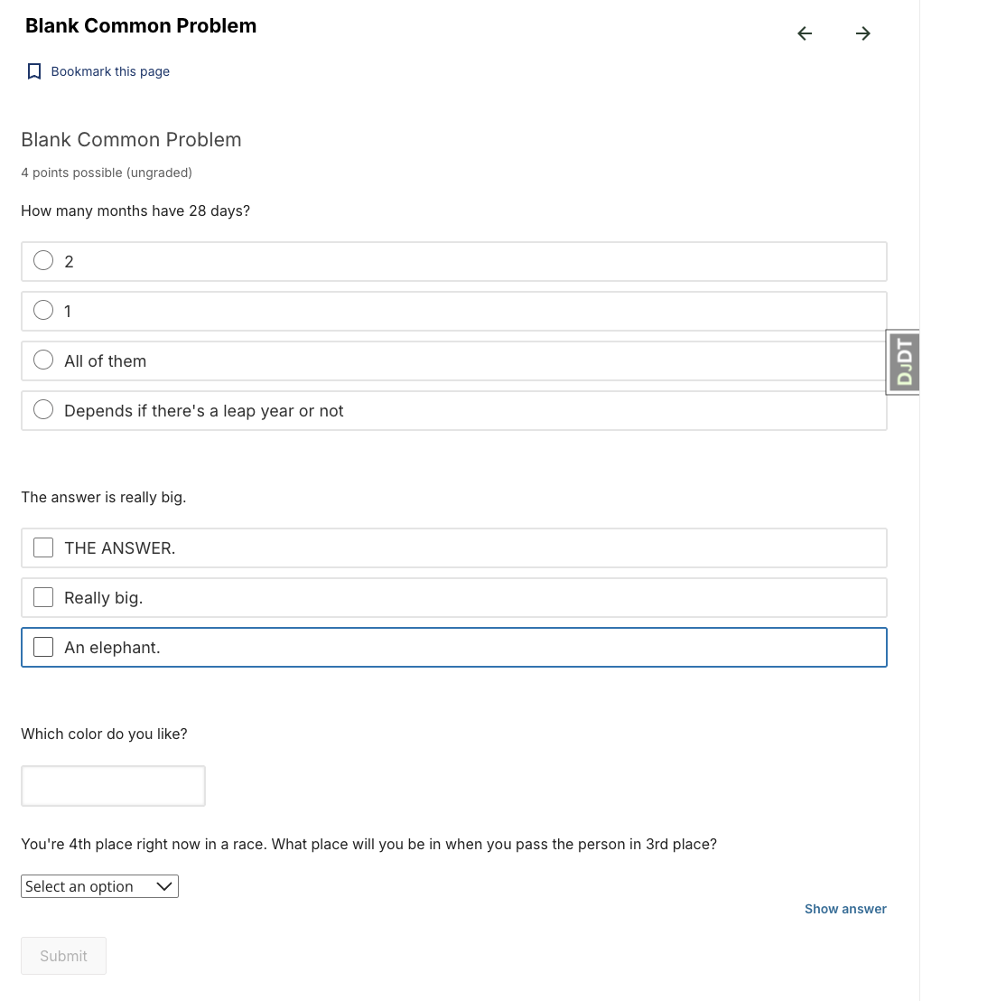
Advanced Problem XBlock
Blank Common Problem
Notes:
Online assessment should be as dynamic as learning itself. XBlocks like xblock-sortable introduce drag-and-drop interfaces for tasks that require categorization or sequencing. These are especially useful in fields like language learning and data analysis.
xblock-free-text-response enhances writing skills by capturing long-form responses and enabling either human or automated review. This flexibility supports writing-intensive disciplines and nuanced assessments.
xblock-inline-dropdown adds interactivity to reading by embedding quizzes directly into the content. Learners can engage with material while being tested in real time. Together, these tools diversify assessment strategies and make evaluation both formative and learner-centric.

Slide 38
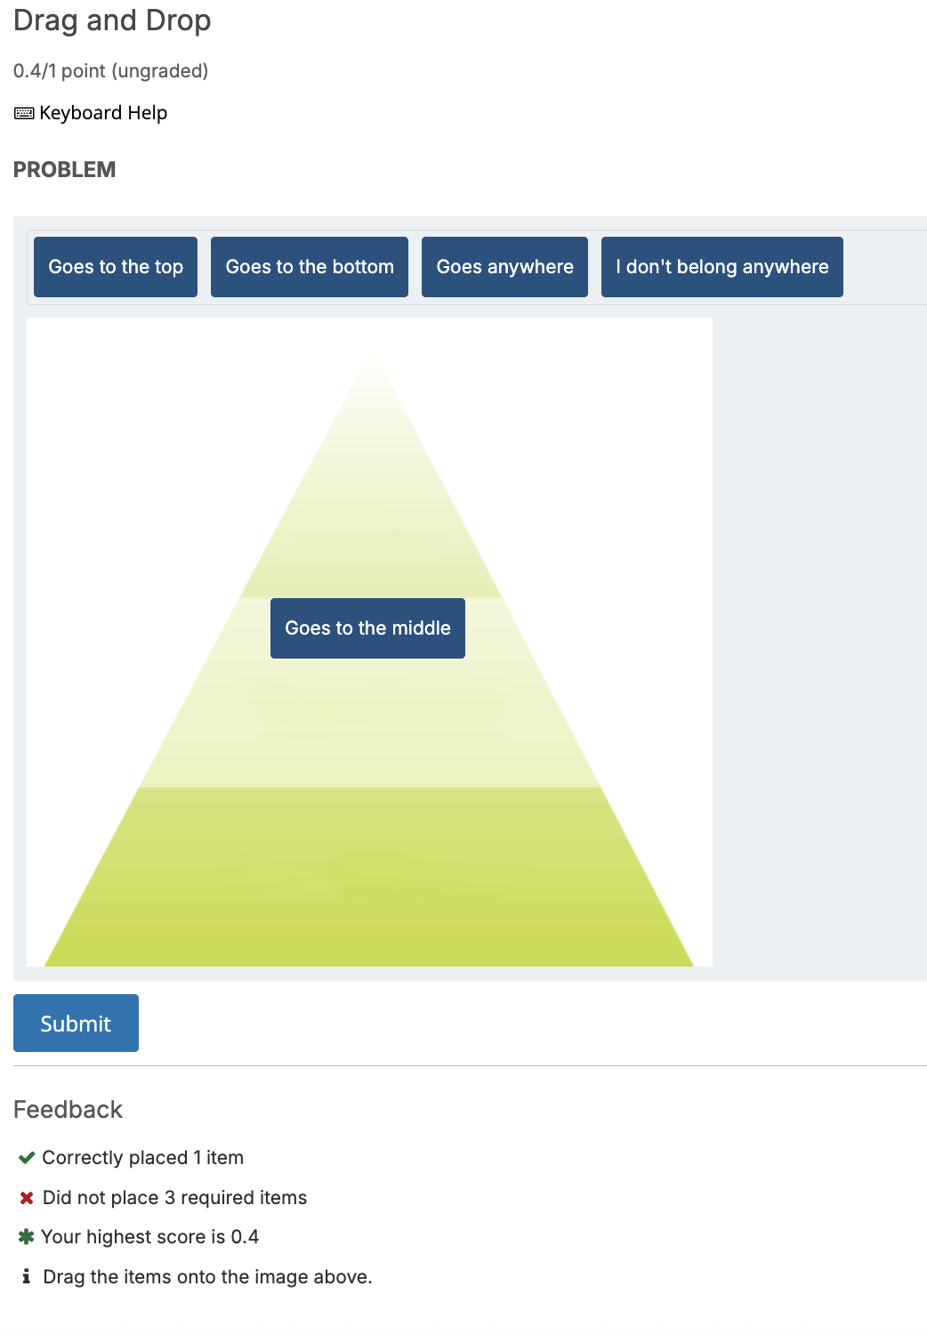
Drag and Drop XBlock
This XBlock offers an interactive drag-and-drop activity, allowing learners to match items to target zones within an image.
Notes:
Online assessment should be as dynamic as learning itself. XBlocks like xblock-sortable introduce drag-and-drop interfaces for tasks that require categorization or sequencing. These are especially useful in fields like language learning and data analysis.
xblock-free-text-response enhances writing skills by capturing long-form responses and enabling either human or automated review. This flexibility supports writing-intensive disciplines and nuanced assessments.
xblock-inline-dropdown adds interactivity to reading by embedding quizzes directly into the content. Learners can engage with material while being tested in real time. Together, these tools diversify assessment strategies and make evaluation both formative and learner-centric.

Slide 39
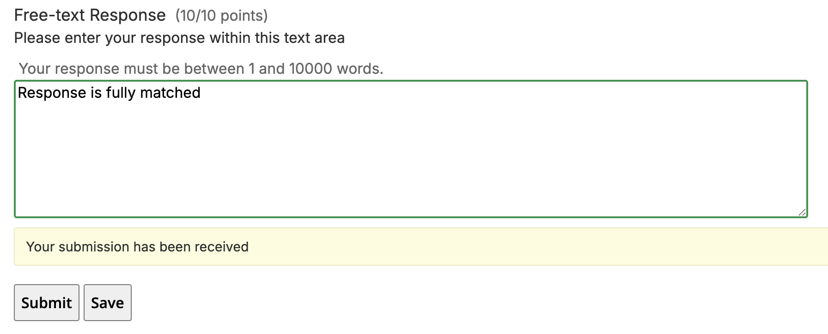
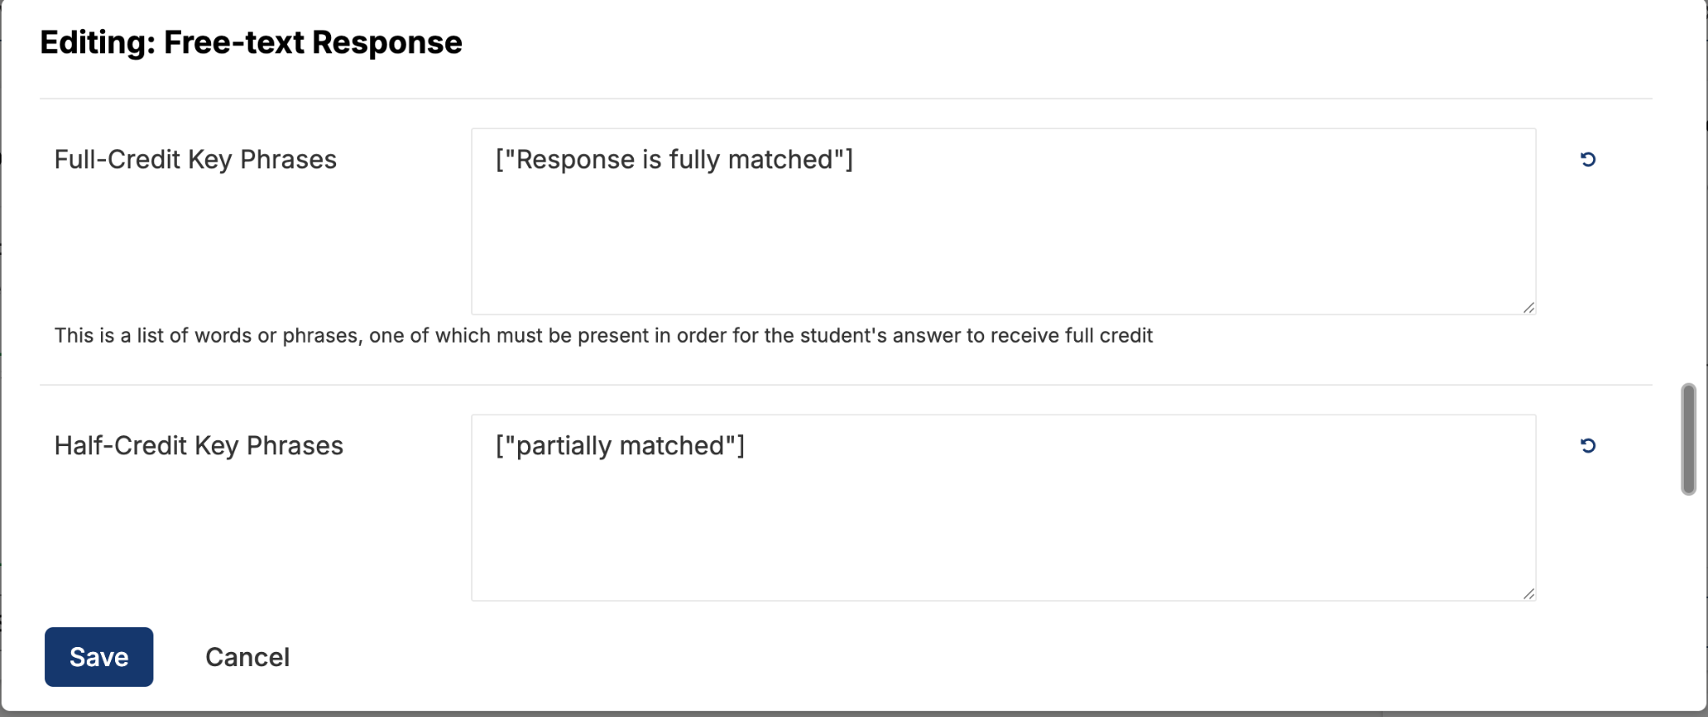
Free-text Response XBlock
Instructors can design questions that allow learners to submit free-text responses.
Notes:
Online assessment should be as dynamic as learning itself. XBlocks like xblock-sortable introduce drag-and-drop interfaces for tasks that require categorization or sequencing. These are especially useful in fields like language learning and data analysis.
xblock-free-text-response enhances writing skills by capturing long-form responses and enabling either human or automated review. This flexibility supports writing-intensive disciplines and nuanced assessments.
xblock-inline-dropdown adds interactivity to reading by embedding quizzes directly into the content. Learners can engage with material while being tested in real time. Together, these tools diversify assessment strategies and make evaluation both formative and learner-centric.

Slide 40
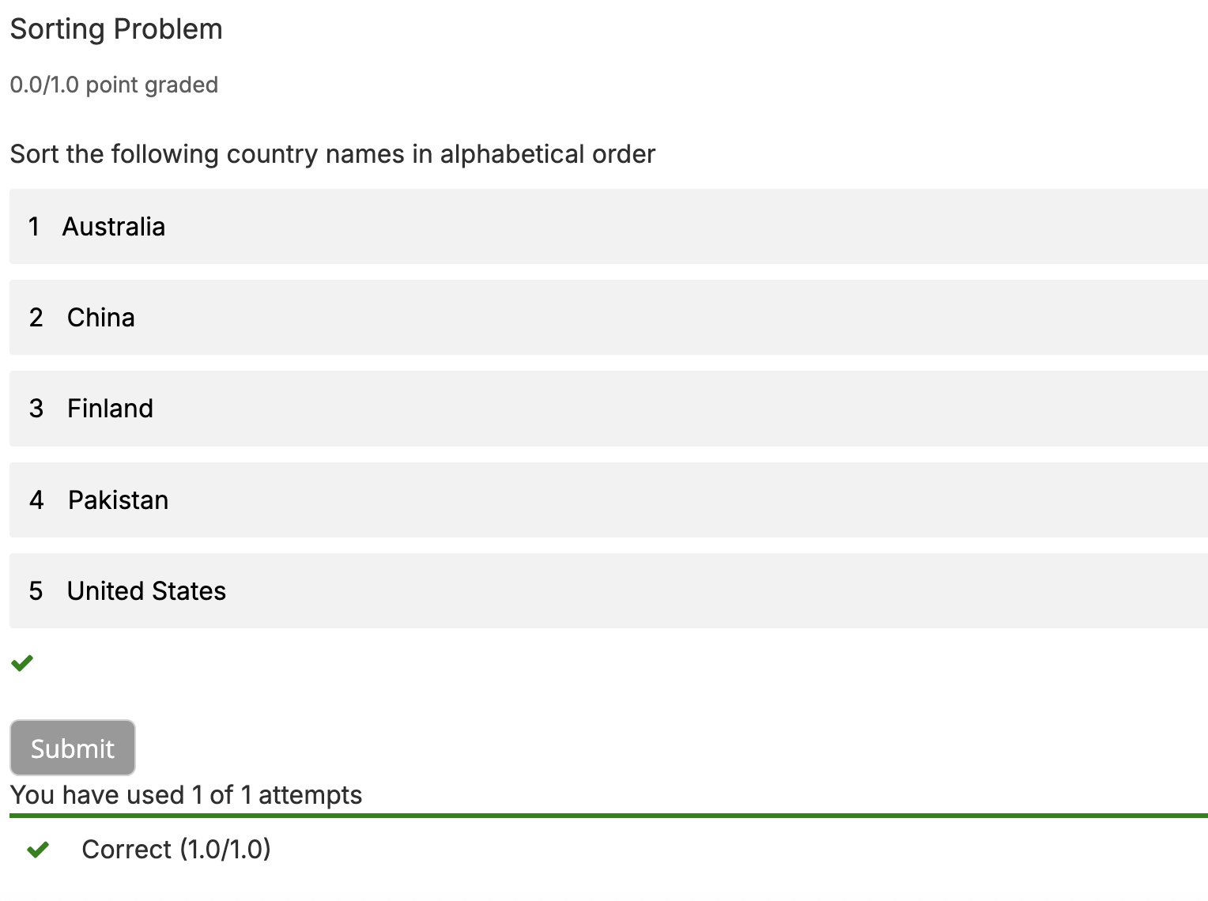

Sortable Problem XBlock
Learners have to sort items by dragging them at their correct position. Authors can define items and their correct order from studio.
Notes:
Online assessment should be as dynamic as learning itself. XBlocks like xblock-sortable introduce drag-and-drop interfaces for tasks that require categorization or sequencing. These are especially useful in fields like language learning and data analysis.
xblock-free-text-response enhances writing skills by capturing long-form responses and enabling either human or automated review. This flexibility supports writing-intensive disciplines and nuanced assessments.
xblock-inline-dropdown adds interactivity to reading by embedding quizzes directly into the content. Learners can engage with material while being tested in real time. Together, these tools diversify assessment strategies and make evaluation both formative and learner-centric.

Slide 41
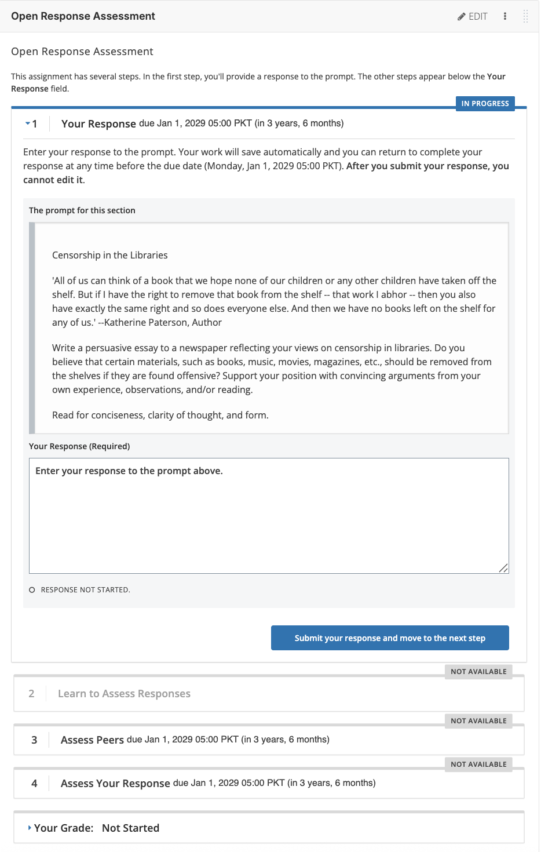
Open Response Assessment XBlock
In Open Response Assessment (ORA), learners submit essay type responses and then go through a series of assessment steps to complete the assignment.
Steps:
Self Assessment
Learn Assessment
Peer Assessment
Notes:
Online assessment should be as dynamic as learning itself. XBlocks like xblock-sortable introduce drag-and-drop interfaces for tasks that require categorization or sequencing. These are especially useful in fields like language learning and data analysis.
xblock-free-text-response enhances writing skills by capturing long-form responses and enabling either human or automated review. This flexibility supports writing-intensive disciplines and nuanced assessments.
xblock-inline-dropdown adds interactivity to reading by embedding quizzes directly into the content. Learners can engage with material while being tested in real time. Together, these tools diversify assessment strategies and make evaluation both formative and learner-centric.

Slide 42

AI-Powered
XBlocks

Slide 43
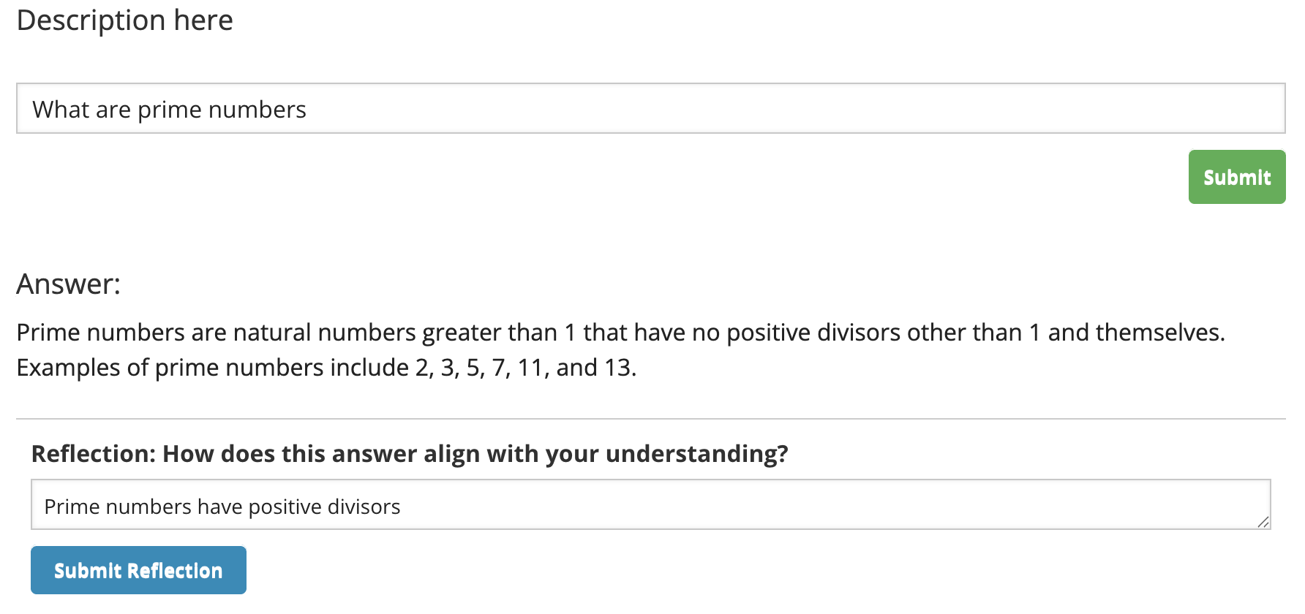
ChatGPT XBlock
The ChatGPT XBlock integrates ChatGPT (AI language model developed by OpenAI).
This XBlock allows learner to ask questions and receive real-time responses, which will enhance their learning experience with an interactive assistant.
Notes:
Online assessment should be as dynamic as learning itself. XBlocks like xblock-sortable introduce drag-and-drop interfaces for tasks that require categorization or sequencing. These are especially useful in fields like language learning and data analysis.
xblock-free-text-response enhances writing skills by capturing long-form responses and enabling either human or automated review. This flexibility supports writing-intensive disciplines and nuanced assessments.
xblock-inline-dropdown adds interactivity to reading by embedding quizzes directly into the content. Learners can engage with material while being tested in real time. Together, these tools diversify assessment strategies and make evaluation both formative and learner-centric.

Slide 44
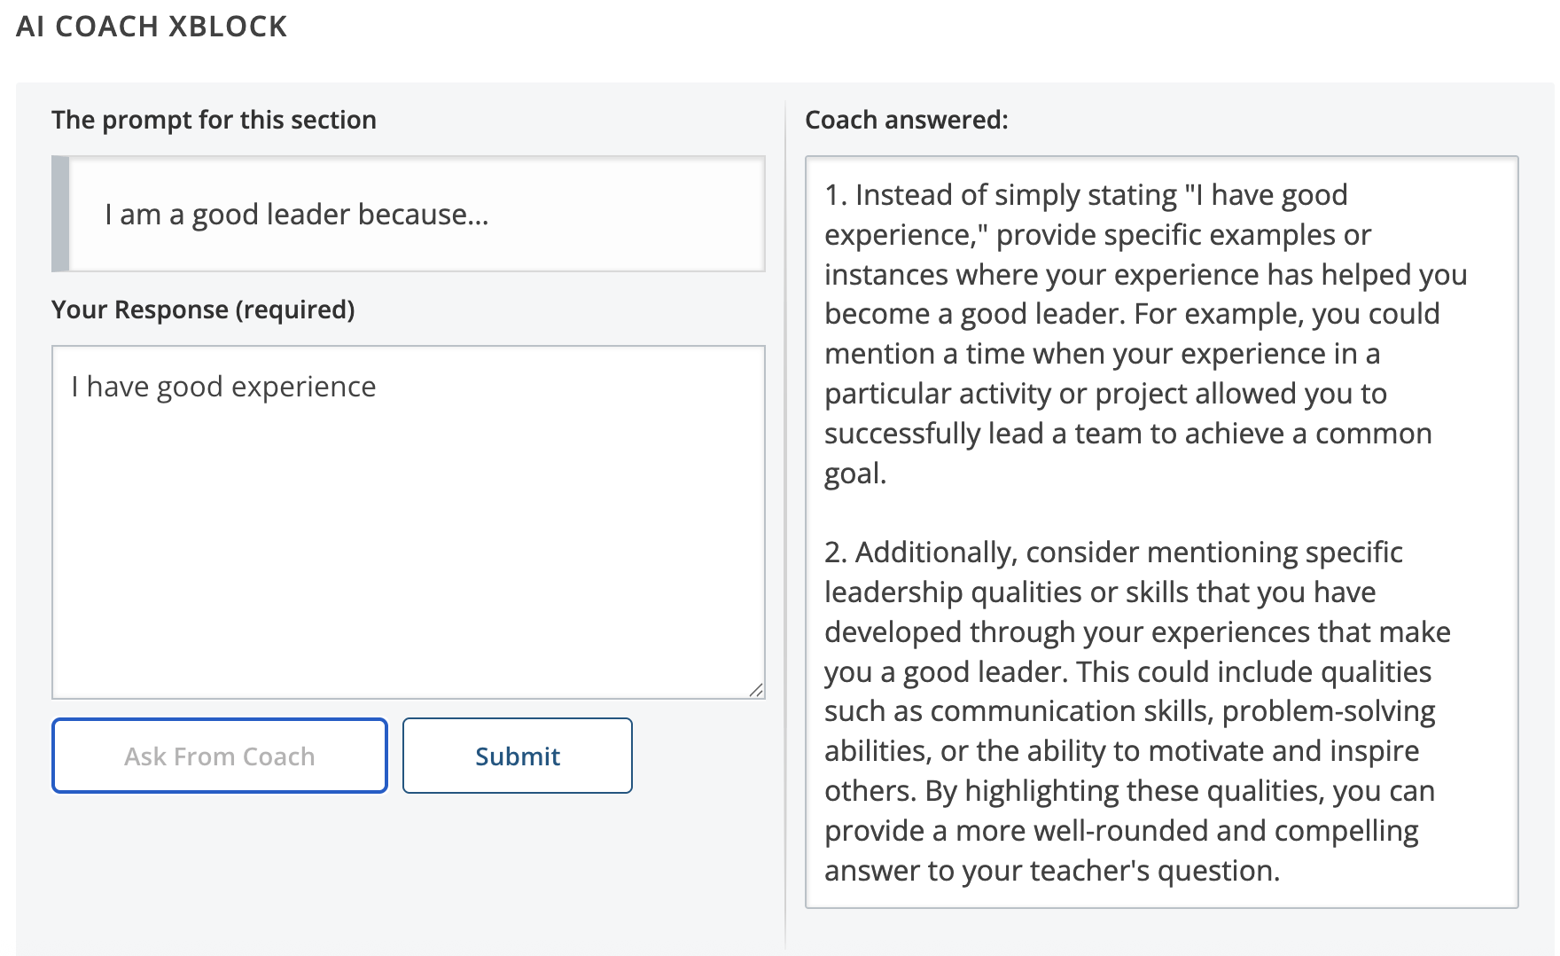
AI Coach XBlock
AI Coach Xblock helps learner in improving their answers by levering power of AI.
Notes:
Online assessment should be as dynamic as learning itself. XBlocks like xblock-sortable introduce drag-and-drop interfaces for tasks that require categorization or sequencing. These are especially useful in fields like language learning and data analysis.
xblock-free-text-response enhances writing skills by capturing long-form responses and enabling either human or automated review. This flexibility supports writing-intensive disciplines and nuanced assessments.
xblock-inline-dropdown adds interactivity to reading by embedding quizzes directly into the content. Learners can engage with material while being tested in real time. Together, these tools diversify assessment strategies and make evaluation both formative and learner-centric.

Slide 45
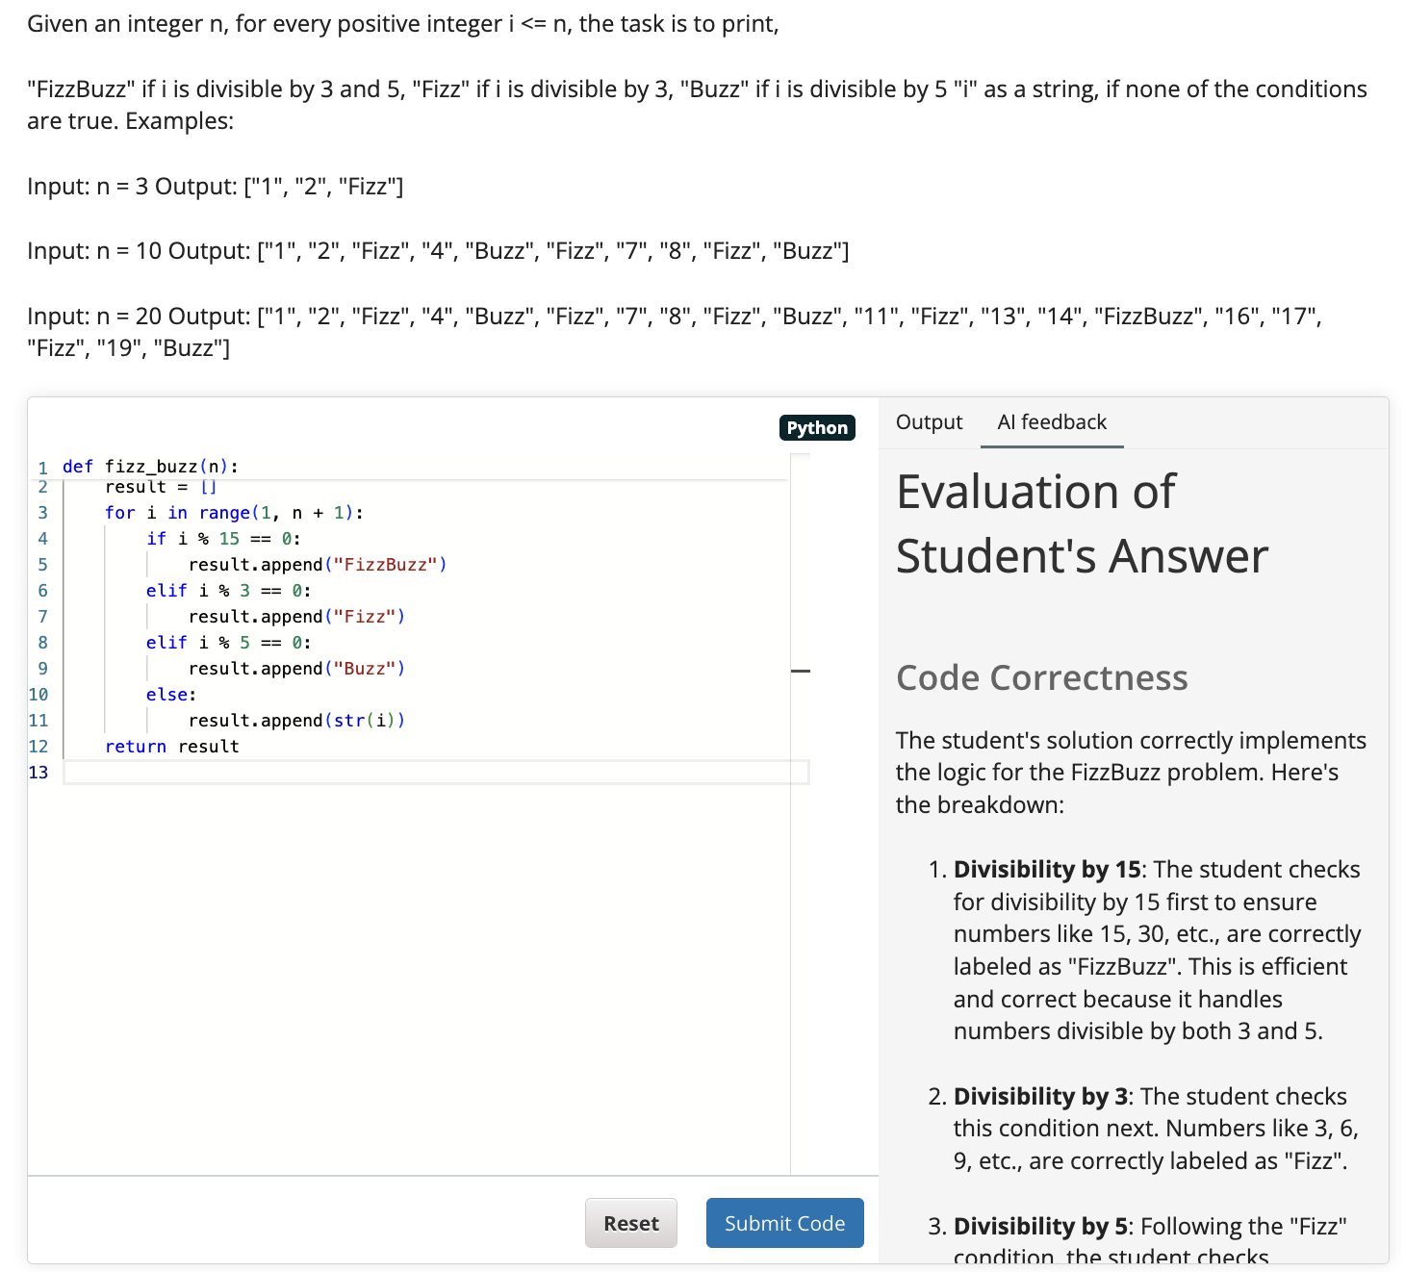
Coding with AI Evaluation XBlock
This XBlock enables learners to write and submit code directly within the course, with automatic evaluation powered by AI
Notes:
Online assessment should be as dynamic as learning itself. XBlocks like xblock-sortable introduce drag-and-drop interfaces for tasks that require categorization or sequencing. These are especially useful in fields like language learning and data analysis.
xblock-free-text-response enhances writing skills by capturing long-form responses and enabling either human or automated review. This flexibility supports writing-intensive disciplines and nuanced assessments.
xblock-inline-dropdown adds interactivity to reading by embedding quizzes directly into the content. Learners can engage with material while being tested in real time. Together, these tools diversify assessment strategies and make evaluation both formative and learner-centric.

Slide 46
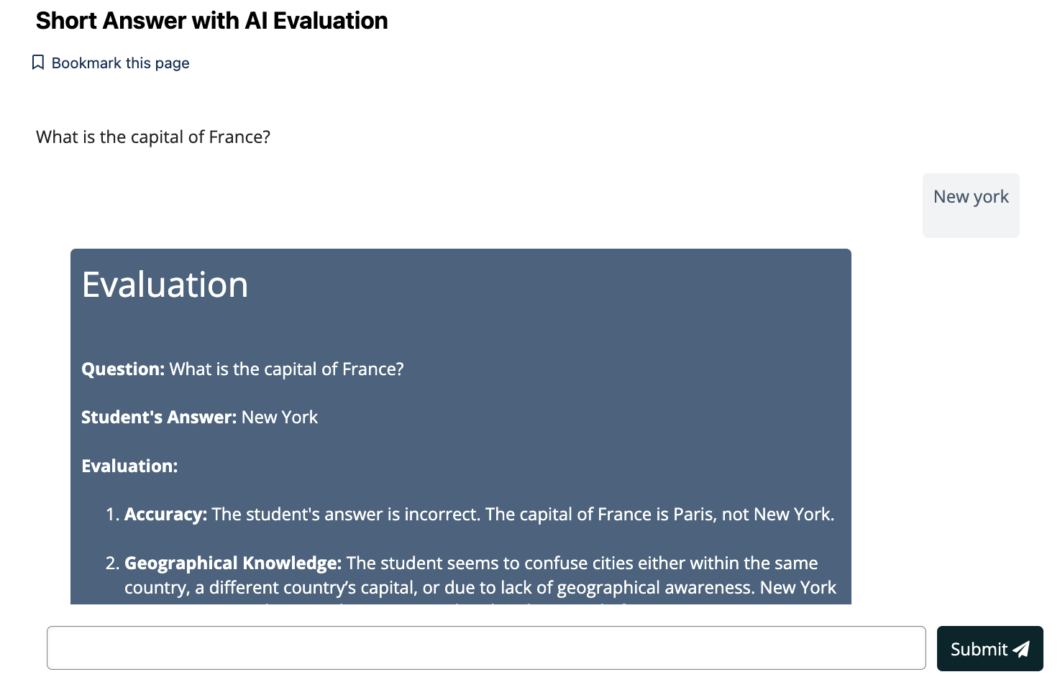
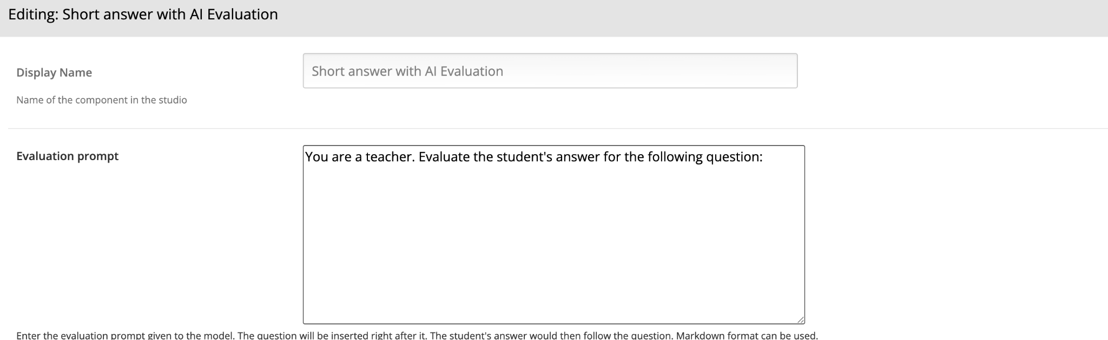
Short Answer with AI Evaluation XBlock
This XBlock allows learners to submit short text responses, which are automatically evaluated using AI for relevance and accuracy.
Notes:
Online assessment should be as dynamic as learning itself. XBlocks like xblock-sortable introduce drag-and-drop interfaces for tasks that require categorization or sequencing. These are especially useful in fields like language learning and data analysis.
xblock-free-text-response enhances writing skills by capturing long-form responses and enabling either human or automated review. This flexibility supports writing-intensive disciplines and nuanced assessments.
xblock-inline-dropdown adds interactivity to reading by embedding quizzes directly into the content. Learners can engage with material while being tested in real time. Together, these tools diversify assessment strategies and make evaluation both formative and learner-centric.

Slide 47
XBlocks Demo Course
Notes:
To bridge theory with practice, we’re developing a comprehensive demo course that integrates the full spectrum of XBlocks discussed. This live sandbox enables participants to explore each XBlock in its natural context—interacting with it just as learners would.
The goal is not only to demonstrate capabilities but to provide a turnkey solution for institutions and educators looking to integrate XBlocks. From drag-and-drop assessments to embedded Jupyter notebooks, this course will serve as a powerful reference and experimentation ground.
By standardizing access to example implementations, we reduce onboarding friction, improve discoverability, and accelerate the broader adoption of community-developed XBlocks.

Slide 48

Feedback & Analytics
XBlocks

Slide 49
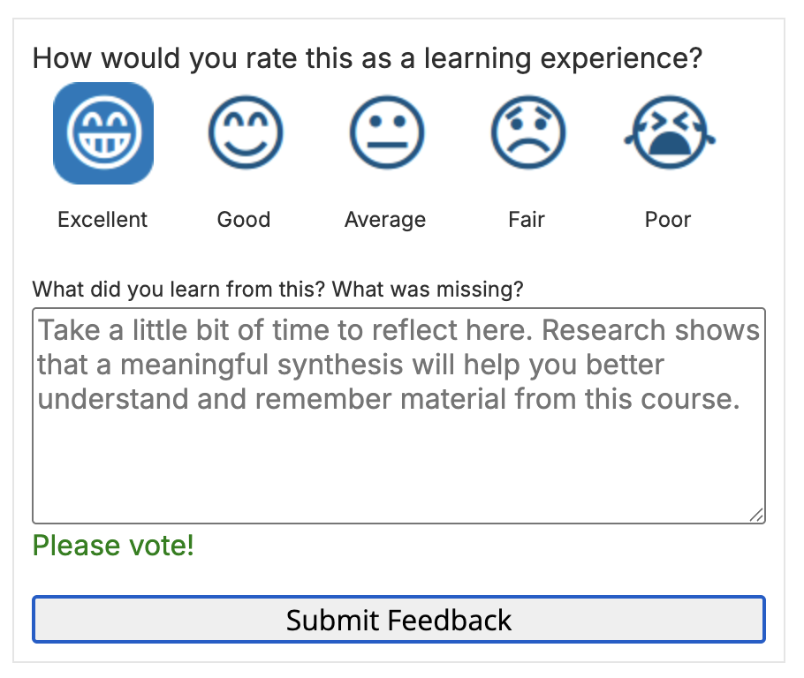
Feedback XBlock
By using this xblock learners can share how they feel about the course using ratings and comments. Instructors can use this feedback to see what’s working well and what needs improvement.
Notes:
Online assessment should be as dynamic as learning itself. XBlocks like xblock-sortable introduce drag-and-drop interfaces for tasks that require categorization or sequencing. These are especially useful in fields like language learning and data analysis.
xblock-free-text-response enhances writing skills by capturing long-form responses and enabling either human or automated review. This flexibility supports writing-intensive disciplines and nuanced assessments.
xblock-inline-dropdown adds interactivity to reading by embedding quizzes directly into the content. Learners can engage with material while being tested in real time. Together, these tools diversify assessment strategies and make evaluation both formative and learner-centric.

Slide 50
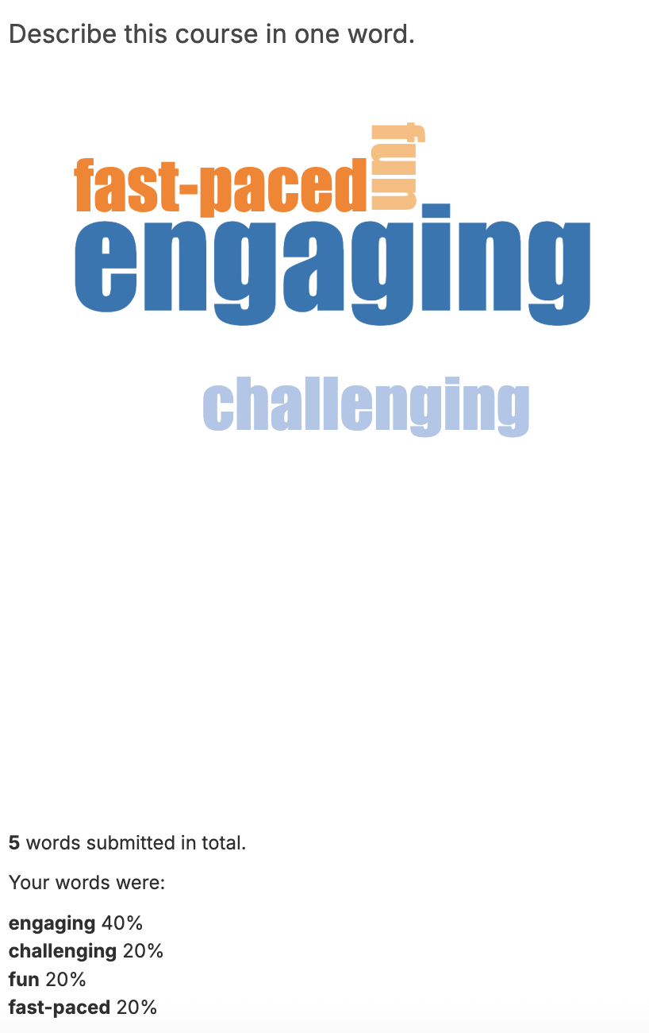

Word Cloud XBlock
The Word Cloud XBlock lets learners to submit words or short phrases in response to a prompt. These responses are then displayed in a word cloud.
Frequently submitted words appear larger.
Less frequent words appear smaller.
Notes:
Online assessment should be as dynamic as learning itself. XBlocks like xblock-sortable introduce drag-and-drop interfaces for tasks that require categorization or sequencing. These are especially useful in fields like language learning and data analysis.
xblock-free-text-response enhances writing skills by capturing long-form responses and enabling either human or automated review. This flexibility supports writing-intensive disciplines and nuanced assessments.
xblock-inline-dropdown adds interactivity to reading by embedding quizzes directly into the content. Learners can engage with material while being tested in real time. Together, these tools diversify assessment strategies and make evaluation both formative and learner-centric.

Slide 51


Qualtrics Survey XBlock
Using this XBlock, instructor can easily add a link to a Qualtrics survey within the course.
Notes:
Online assessment should be as dynamic as learning itself. XBlocks like xblock-sortable introduce drag-and-drop interfaces for tasks that require categorization or sequencing. These are especially useful in fields like language learning and data analysis.
xblock-free-text-response enhances writing skills by capturing long-form responses and enabling either human or automated review. This flexibility supports writing-intensive disciplines and nuanced assessments.
xblock-inline-dropdown adds interactivity to reading by embedding quizzes directly into the content. Learners can engage with material while being tested in real time. Together, these tools diversify assessment strategies and make evaluation both formative and learner-centric.

Slide 52

Survey XBlock
Survey XBlock can be used to configure multiple questions and multiple possible answers.
Notes:
Online assessment should be as dynamic as learning itself. XBlocks like xblock-sortable introduce drag-and-drop interfaces for tasks that require categorization or sequencing. These are especially useful in fields like language learning and data analysis.
xblock-free-text-response enhances writing skills by capturing long-form responses and enabling either human or automated review. This flexibility supports writing-intensive disciplines and nuanced assessments.
xblock-inline-dropdown adds interactivity to reading by embedding quizzes directly into the content. Learners can engage with material while being tested in real time. Together, these tools diversify assessment strategies and make evaluation both formative and learner-centric.

Slide 53
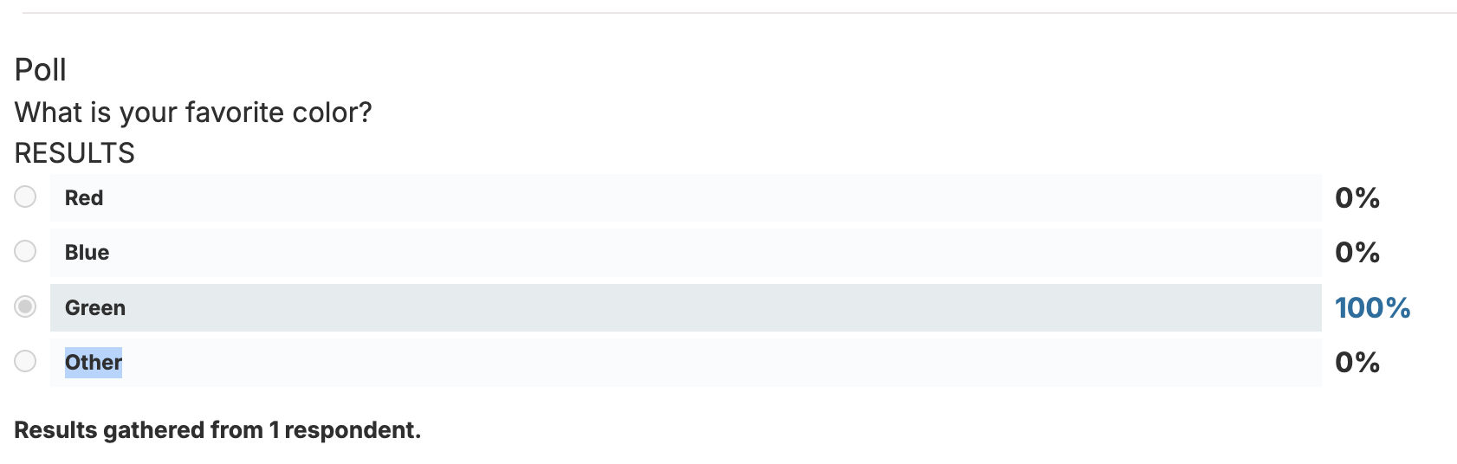
Poll XBlock
The Poll XBlock lets instructors ask single-question polls to gather learner opinions.
Notes:
Online assessment should be as dynamic as learning itself. XBlocks like xblock-sortable introduce drag-and-drop interfaces for tasks that require categorization or sequencing. These are especially useful in fields like language learning and data analysis.
xblock-free-text-response enhances writing skills by capturing long-form responses and enabling either human or automated review. This flexibility supports writing-intensive disciplines and nuanced assessments.
xblock-inline-dropdown adds interactivity to reading by embedding quizzes directly into the content. Learners can engage with material while being tested in real time. Together, these tools diversify assessment strategies and make evaluation both formative and learner-centric.

Slide 54

Q&A
Any questions?

Slide 55

See you at
Edly Booth
Don’t forget to get free goodies

Slide 56
References
XBlock docs
XBlock API Guide
Appsembler blog

